Slide 1
WK 01 – Big Data
PPOL 5206 – Massive Data Fundamentals
Spring 2025

Slide 2
Objectives
Defining Big Data
Challenges of Big Data
Solutions
Uses

Slide 3
What is Big Data?
What is data?
Text
Dates & Times
Numbers
Audio
Images
Signals
Sensor readings
Etc…

Slide 4
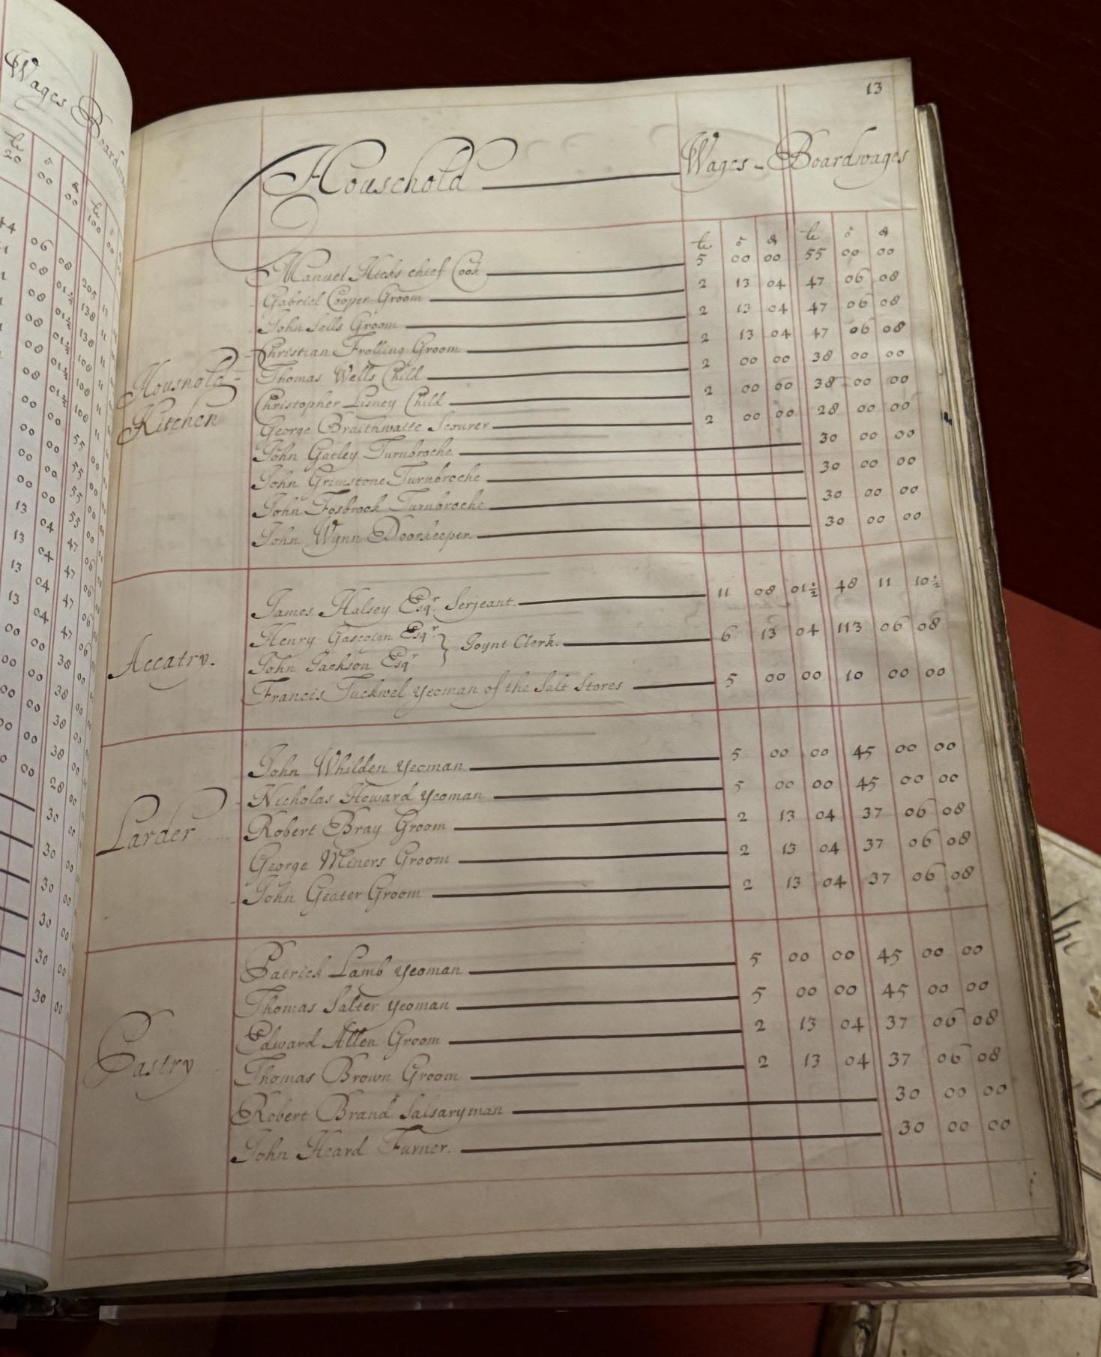
Big Data: 1700s
Account log book from Kensington Palace

Slide 5
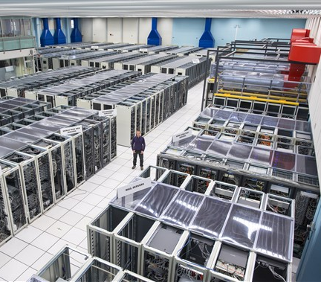
Big Data: 2020s
Computing center at CERN

Slide 6
What is Big Data?
“
Big data can be described in terms of data management challenges that – due to increasing volume, velocity and variety of data – cannot be solved with traditional databases. While there are plenty of definitions for big data, most of them include the concept of what’s commonly known as “three V’s” of big data:
Volume: Ranges from terabytes to petabytes of data
Variety: Includes data from a wide range of sources and formats (e.g. web logs, social media interactions, ecommerce and online transactions, financial transactions, etc.
Velocity: Increasingly, businesses have stringent requirements from the time data is generated, to the time actionable insights are delivered to the users. Therefore, data needs to be collected, stored, processed, and analyzed within relatively short windows – ranging from daily to real-time
”
- AWS: “What is Big Data?”

Slide 7
What is Big Data?
“Big Data consists of extensive datasets-primarily in the characteristics of volume, variety, velocity, and/or variability-that require a scalable architecture for efficient storage, manipulation, and analysis.”
- NIST Big Data Interoperability Framework

Slide 8
What is Big Data?
“A big data architecture is designed to handle the ingestion, processing, and analysis of data that is too large or complex for traditional database systems.
The threshold at which organizations enter into the big data realm differs, depending on the capabilities of the users and their tools. For some, it can mean hundreds of gigabytes of data, while for others it means hundreds of terabytes.
As tools for working with big datasets advance, so does the meaning of big data. More and more, this term relates to the value you can extract from your data sets through advanced analytics, rather than strictly the size of the data, although in these cases they tend to be quite large.”
- Azure: “Big Data Architectures”

Slide 9
What is Big Data?
Definition changes over time
Distinguished by certain attributes
Data that requires special computing tools and methods
Storage
Compute
I/O
Data that requires special concepts:
Governance
Algorithms

Slide 10
V’s for Big Data
Volume
The amount of data
Velocity
The speed data is generated, collected, and processed
Variety
The diversity of data types

Slide 11
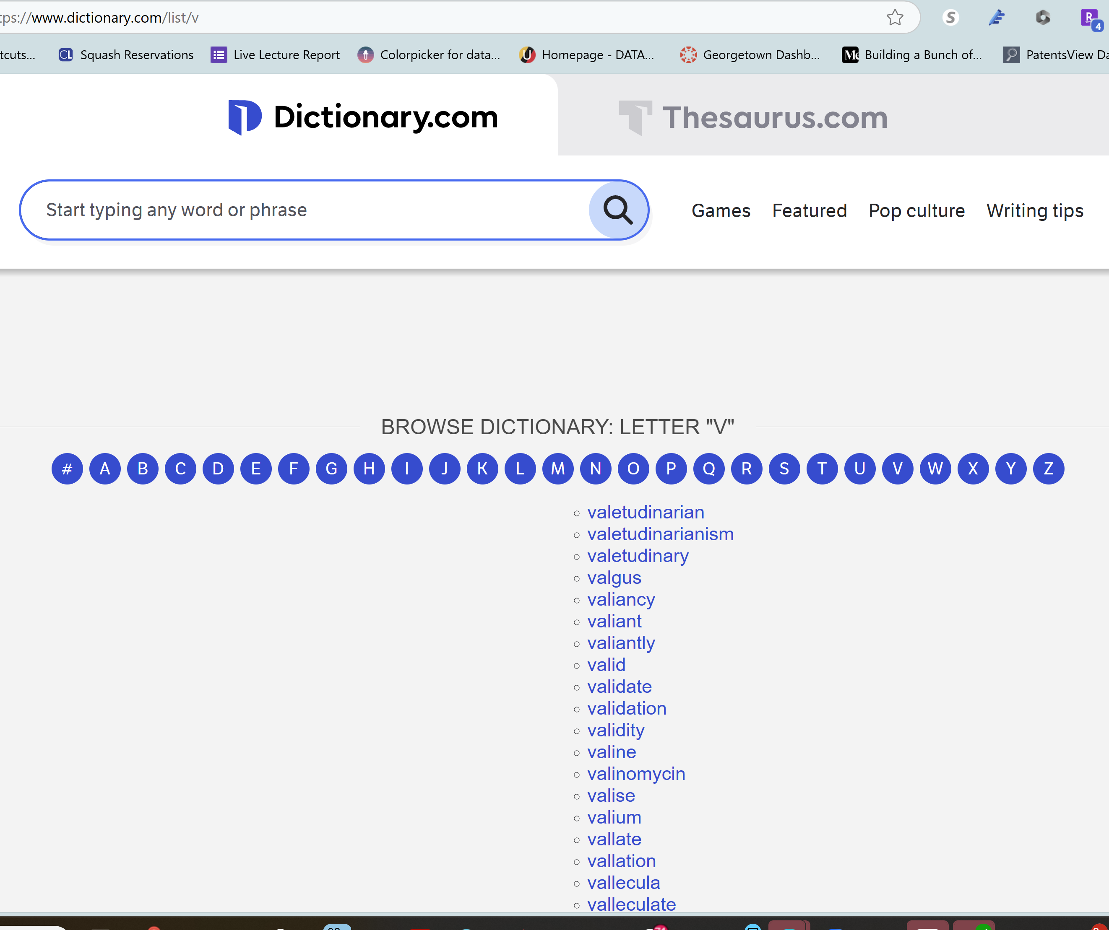
And some more V’s…
Veracity: The quality and reliability of data, ensuring accuracy and trustworthiness.
Value: The usefulness and insights derived from the data to make informed decisions.
Variability: The inconsistency of data, which can complicate processing and analysis.
Visualization: The ability to represent data in an understandable and actionable format.
Volatility: The lifespan of data and how long it remains relevant or useful.
Validity: The correctness and applicability of data for its intended use.

Slide 12

Where did Big Data come from?

Slide 13
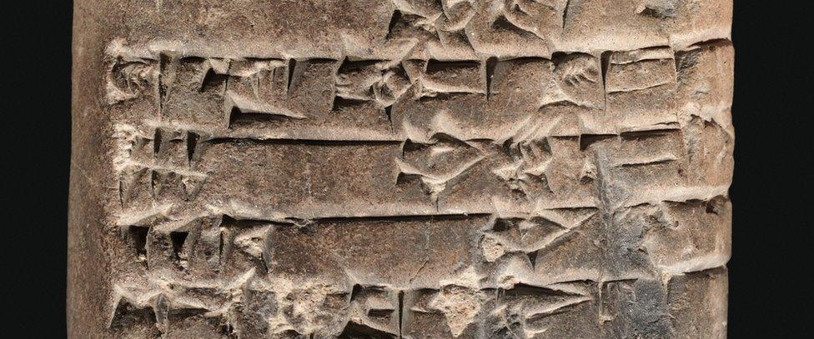
The First Recorded Data
How the world's first accountants counted on cuneiform - BBC News

Slide 14
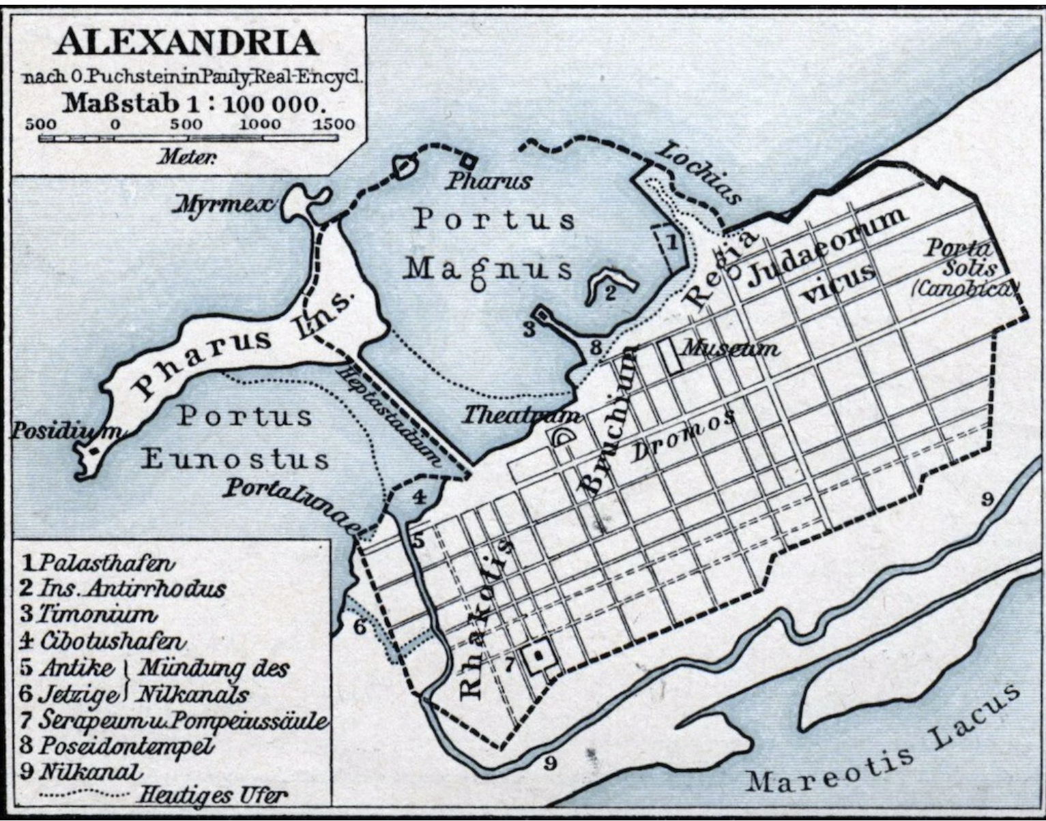
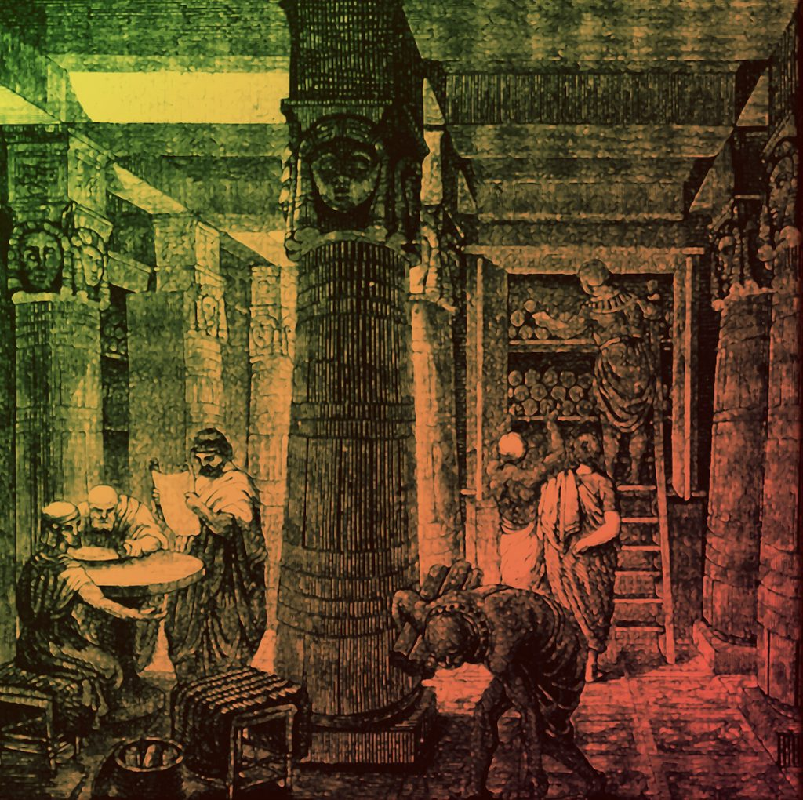
Data Gathering and Storage
History of the Ancient Library of Alexandria - Historic Mysteries
Notes:
Library of Alexandria:
The idea of recording data

Slide 15
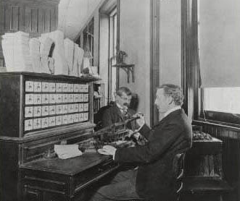
Encoding Data
Following the 1880 census, the Census Bureau was collecting more data than it could tabulate.
The agency held a competition in 1888 to find a more efficient method to process and tabulate data.
Three contestants accepted the challenge:
The first two contestants captured the data in 144.5 hours and 100.5 hours.
The third contestant, a former Census Bureau employee named Herman Hollerith, completed the data capture process in 72.5 hours.
Next, the contestants had to prove that their designs could prepare data for tabulation
(i.e., by age category, race, gender, etc.).
Two contestants required 44.5 hours and 55.5 hours.
Hollerith completed the task in just 5.5 hours.
His company is a direct predecessor of IBM
Census.gov: The Hollerith Machine

Slide 16

Digital Data
ENIAC was the first programmable
electronic
general purpose
digital
Computer
Completed in 1945
(some) can be visited at UPenn

Slide 17
Our Story So Far
Governments and companies were collecting vast amounts of data
But they had difficulty:
Making it available
Performing analysis
Time-sharing compute systems built on mainframes
Theoretical developments such as relational databases
Software systems such as the SQL standard

Slide 18
Data Goes Public
1985: NSF considered how it could provide greater access to the high-end computing resources at its recently established supercomputer centers
1986: NSFNET went online
connected the supercomputer centers at 56,000 bits per second
1988: Links were upgraded to 1.5 megabits per second
1991:
NSFNET backbone became the first national 45-megabits-per-second Internet network
The launch of the World Wide Web in 1991 by Tim Berners-Lee and colleagues at CERN
1993:
Over 2 million computers are connected to NSFNET
National Information Infrastructure Act of 1993, passed by the U.S. Congress, required NSF to allow public access over NSFNET
1995: NSF awarded contracts 3 network access points, to provide connection points between commercial networks, and one routing arbiter
1998: NSF transferred its NAPs and routing arbiter to the private sector
A Brief History of NSF and the Internet | NSF - National Science Foundation

Slide 19
What Produces Big Data?
Social Media Data
Stock Exchange Data
Power Grid Data
Transport Data
Search Engine Data
Sensor data
Etc….

Slide 20
Types of Data
Structured
SQL
Relational Databases
Semi-Structured
NOSQL
Key:Value stores (JSON, XML)
Unstructured
BLOBs (Audio, Video, pickle)

Slide 21
Structured Data
Organized into a formatted repo (typically a database)
Data that can be stored into rows and columns
Conforms to a pre-defined schema
Contains relational keys and can be mapped into pre-designated fields
Use Cases:
Customer Relationship Management (CRM) systems
Financial systems and accounting databases
Inventory management systems​

Slide 22
Semi-Structured Data
Information that does not reside in a relational database
Can contains organizational properties that make is easier to analyze
Sometimes can be stored in a relational database, however not often
Use Cases:
Content management systems
E-commerce platforms storing product information
Applications requiring flexible and scalable data models​

Slide 23
Unstructured Data
Cannot be organized in a predefined manner
Has no predefined data model
Require alternative platforms for storage and analytics
Social media data storage
Audio/Video files
Internet of Things (IoT) sensor data storage

Slide 24
Small vs Big Data Issues
 | Small Data is usually… | Big Data is usually…
Purpose | Gathered for a specific goal | May or may not be gathered for analytical purpose
Location | One computer / file | Many systems / files
Structure | Tabular or Excel | May have multiple formats
Preparation | End user for their own goals | Prepared and used by separate people
Gathering | Often collected with a single method | May incorporate multiple incorporation methods
Governance | Single source | May involve multiple sources, each with own special rules

Slide 25

Scaling Up for Big Data: Vertical
When you need a bigger boat
Get a “bigger” machine (More CPU, GPU, RAM, Storage, etc.)
Quickly gets more expensive and reaches hardware limits
More downtime
Can be easier to manage

Slide 26
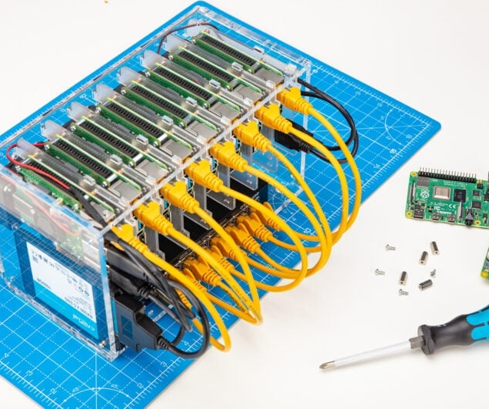
Scaling Out for Big Data: Horizontal
Adding more servers or machines to a system, potentially indefinitely
Can be more difficult to manage
Requires efficient load balancing
Need to maintain data consistency
How to build a Raspberry Pi cluster - Raspberry Pi

Slide 27
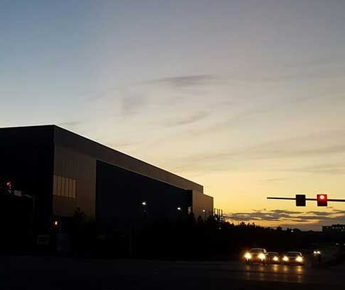
Moving into the Cloud
Outsourcing major computing and networking tasks
Can scale both vertically and horizontally
Access to large-scale technologies at competitive cost
More on this next week…
The Ashburn Data Center Building Boom Hits New Heights | Data Center Frontier

Slide 28
Time for a Break!
And then:
quick lab,
Questions,
Discusison

